Slide 1
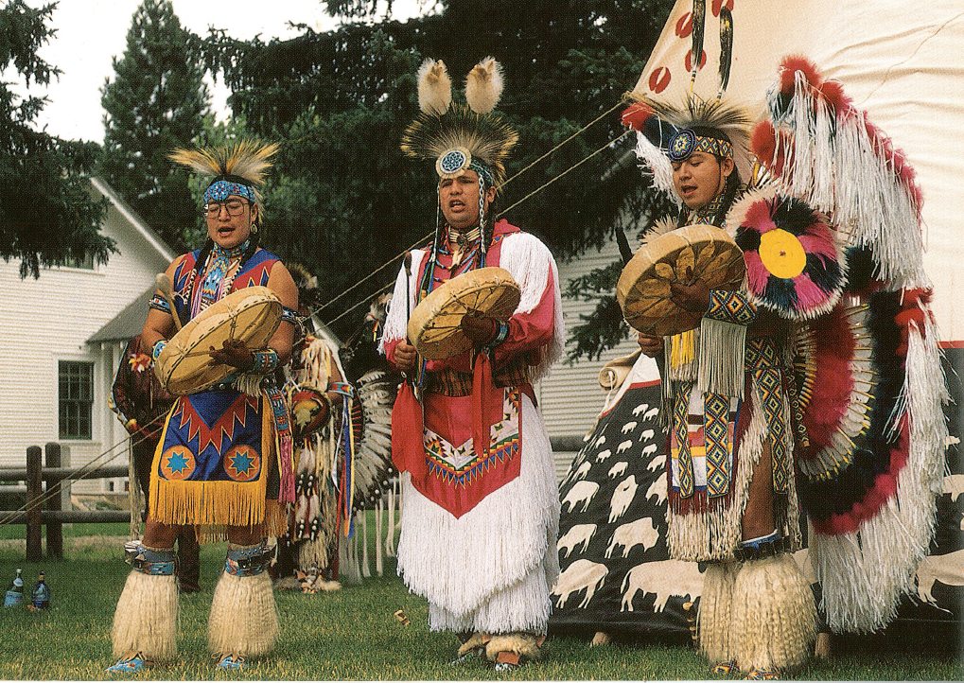
Native Americans—the first American Composers

Slide 2
Instruments--Drums

Slide 3
Instruments--Drums
Algonquin Raccoon Dance

Slide 4
Instruments: Rattles
Haliwa-Saponi Canoe Song

Slide 5
Instruments: Rasp
Southern Ute
Bear Dance

Slide 6
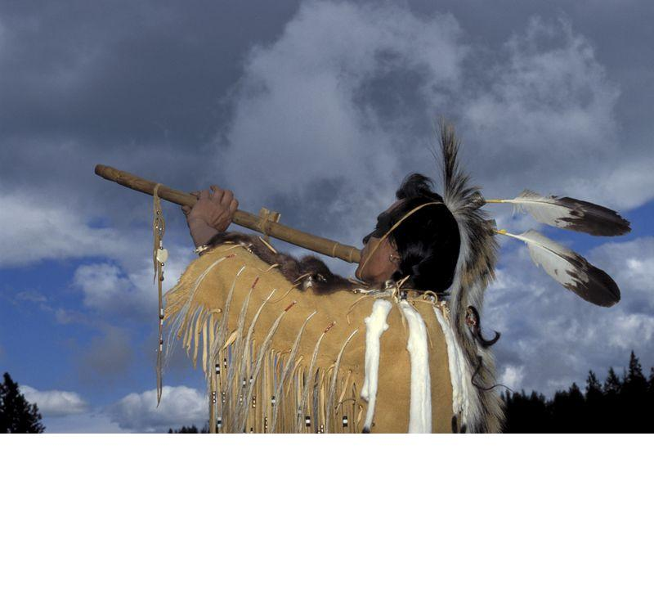
Instruments: Flute
Lakota Lullaby

Slide 7
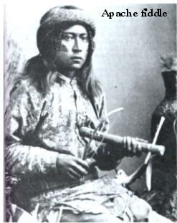
Instruments: Apache Violin

Slide 8
Singing
Melody goes from high to low.
A 5-note or pentatone scale is often used.
Words are sometimes real words, and sometimes just syllables called “vocables.”
Yurok Women’s Brush Dance

Slide 9
Mos Mos

